Slide 1

Blockchain
Sunitha R
Department of Computer Science and Engineering

Slide 2

Blockchain
DECENTRALIZED APPLICATIONS
Sunitha R
Department of Computer Science and Engineering

Slide 3
Blockchain
DECENTRALIZED APPLICATIONS (Dapps)
They are more flexible, transparent, distributed, resilient, and have a better incentivized structure than current software models.
It will work with cryptographically stored ledger.
It is a scarce-asset model, and peer-to-peer technology.

Slide 4
Blockchain
KEY FEATURES
A distributed app, abbreviated as “DApp", is a piece of software that is run on a distributed or cloud network rather than on a single dedicated server.
By distributing the processing power and storage space across many devices, DApps are decentralized, making them more resistant to attack as there is no single point of failure that can be undermined.
Blockchain-based systems have been the platforms upon which many DApps have been built and deployed; however, DApps can also runs on cloud platforms or other network architectures.

Slide 5
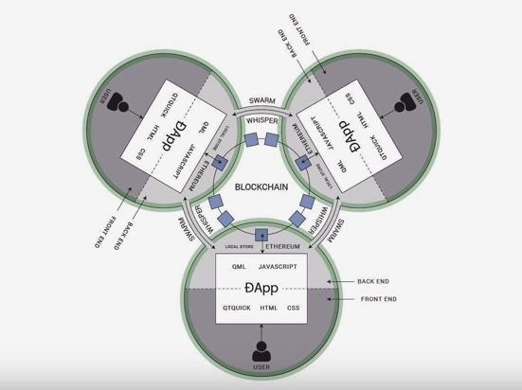
Blockchain
ILLUSTRATION OF DAPP

Slide 6
Blockchain
ILLUSTRATION OF DAPP
Traditional websites: Front End → API → Database.
Front End (including wallet) → Smart Contract → Blockchain.

Slide 7
Blockchain
BLOCKCHAINS AND DISTRIBUTED APPS
In the crypto economy, the blockchain used by most cryptocurrencies uses Distributed Apps to maintain an efficient digital marketplace.
Rather than the conventional client-server network adopted by most centralized organizations, blockchains run on a peer-to-peer network where transactional information carried out between two parties is recorded and shared across multiple computers on the network.

Slide 8
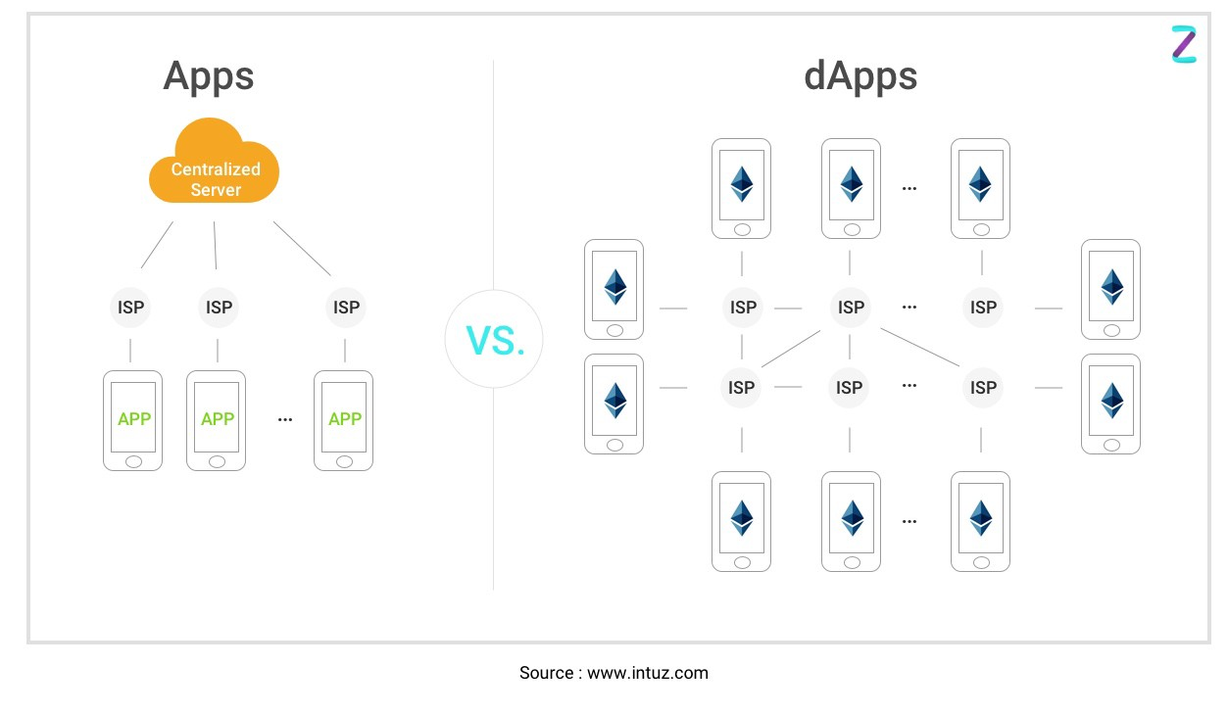
Blockchain
TRADITIONAL V/S DISTRIBUTED

Slide 9
Blockchain
HOW DAPPS FIT IN THE REAL WORLD?
Money Management & Transfer
Business Process Management
DAO (Decentralized Autonomous Organization)

Slide 10
Blockchain
WHY CHOOSE DAPP DEVELOPMENT OVER CONVENTIONAL APP DEVELOPMENT?
Faster & payment processing without needing to integrate payment gateway to accept funds.
High levels of data security due to smart contracts governed by private keys.
Greater anonymity without needing the users to follow the lengthy signup process.
Reliable data records as users can access the public blockchain to verify transaction information.

Slide 11
Blockchain
SUPPLEMENTARY READINGS
https://dappbuilder.io/

Slide 12
THANK YOU
Prof.Sunitha R
Department of Computer Science and Engineering
sunithar@pes.edu

